Slide 1
covid-19-countries-aggregated-part1
File created on: 31-03-2020 18:16:41

Slide 2
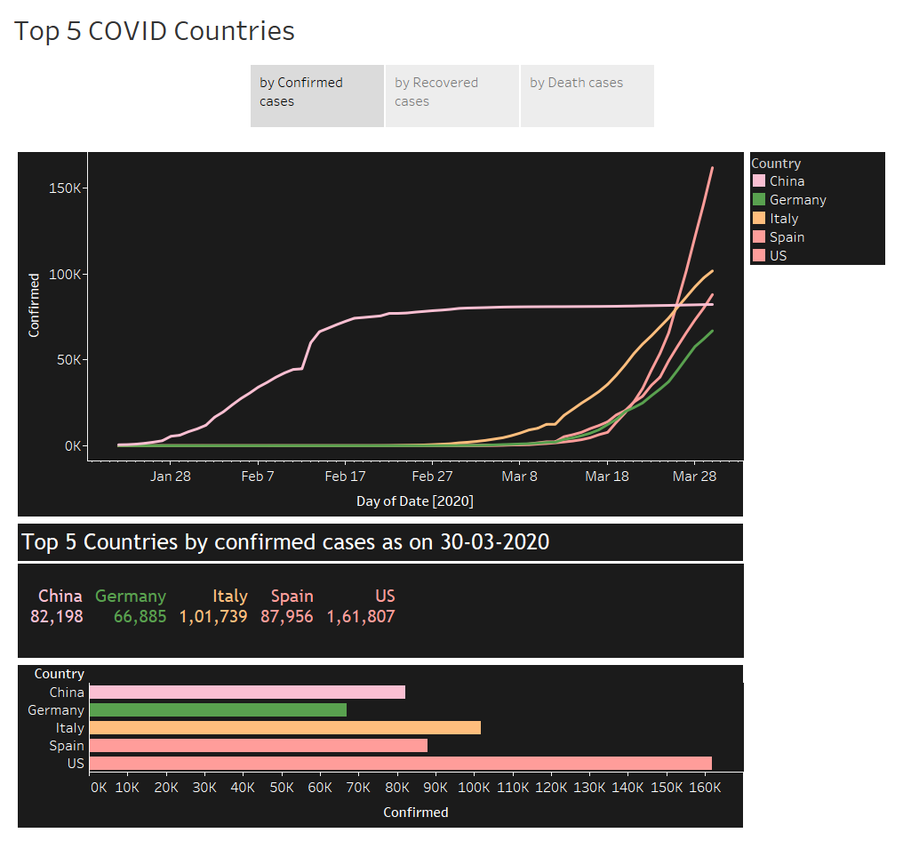

Slide 3
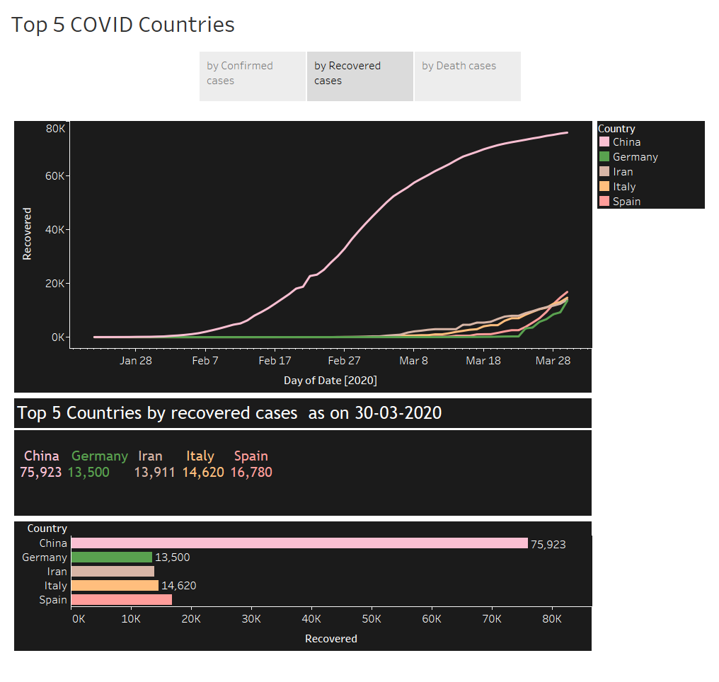

Slide 4
